Slide 1
Ticketing System to help improve customer support

Slide 2
TICKETING SYSTEM TO HELP IMPROVE CUSTOMER SUPPORT
BACKGROUND
FreshDesk Plan Packages
FreshDesk Feature (Sprout Plan)
OPEN ITEMS

Slide 3
BACKGROUND
Freshdesk is a customer support software also classified as a ticketing software or a helpdesk that allows companies to effectively manage their customer care and support function. The primary purpose of the tool is to help companies track and resolve complaints, queries, or any other form of enquiry from customers.

Slide 4
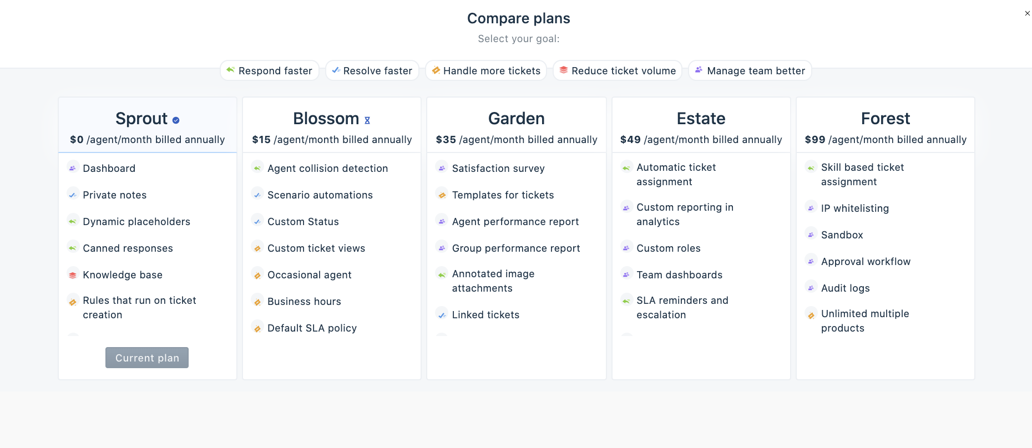
FreshDesk Plan Packages
Currently we are using Sprout Plan since it is free. We will discuss what are the Feature for the Sprout Plan Package.

Slide 5
FreshDesk Features (Sprout Plan)
Dashboard
The dashboard gives you a bird's-eye view of what’s happening in your team, so you can identify bottlenecks and act on them immediately. You can also track your team’s workload, performance, how happy your customers are with their support experience and do a lot more with the dashboard. If you are on the Estate plan or above, you can customize the Freshdesk dashboard by creating widgets to monitor ticket traffic or certain queues, and also use it as a place for internal announcements.

Slide 6
FreshDesk Features (Sprout Plan)
Private note
Private notes help when someone in your team wants to get help from other agents, share progress internally, or log updates on a ticket for future reference, while keeping the customer out of the loop.

Slide 7
FreshDesk Features (Sprout Plan)
Dynamic Placeholders
Placeholders in Freshdesk are a great way to add dynamic content and personalize your emails with their name, ticket status or the ticket URL.

Slide 8
FreshDesk Features (Sprout Plan)
Canned Responses
With canned responses, you can quickly send pre-formatted messages to customers when similar questions come your way. Beyond ensuring consistency and saving your team’s time, it also frees them up to get to more complex questions. You can add commonly sent canned responses as FAQs or solution articles, so your customers find answers to often-asked questions on their own.

Slide 9
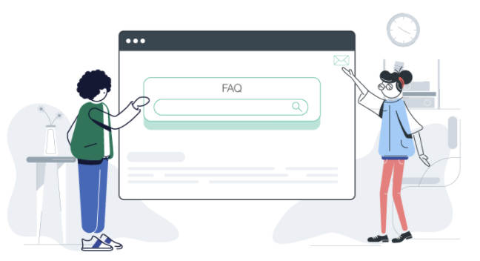
FreshDesk Features (Sprout Plan)
Knowledge Base
70% of customers prefer to use a company’s website to get answers to their questions rather than use phone or email (Forrester). Document how-tos, FAQs or anything informative for your customers so they can find answers themselves without waiting for an agent to get back to them. In addition to articles you create for your customers, you can set up an internal knowledge base that can be used for training your team. You can also leverage capabilities like bulk actions, automatic article reordering, advanced filters and more, to handle your constantly growing knowledge base with ease.

Slide 10
FreshDesk Features (Sprout Plan)
Rules on the ticket creation
Manually looking through every ticket and updating it is time-consuming. Automatically route tickets from certain customers to the best group that can handle it, or even prioritize tickets with certain keywords, with automations. You can ensure important tasks are not forgotten by defining specific actions on time-based and event-based triggers available in your plan.

Slide 11
FreshDesk Features (Sprout Plan)
Ticket volume trend report
Understand the flow of tickets in your account with the ticket volume trends report. Identify peaks in the inflow of tickets and allocate resources accordingly. You can also decide your work hours based the volume of ticket inflow. If you are in the Blossom plan or above, beyond just tracking how many tickets you worked on, you can also get an overview of how long your agents are taking to respond or resolve tickets.

Slide 12
FreshDesk Features (Sprout Plan)
Default ticket views
Instead of having an inbox cluttered with all your customers’ requests, use default ticket views to jump to tickets you work on everyday instead of applying filters each time. For instance, the default ticket view for all unresolved tickets gives you a bird’s eye view of customers waiting for their problems to be sorted out. You can create custom inbox views available in your plan to keep track of pending tickets, tickets assigned to each agent, follow up in bulk and do a lot more.

Slide 13
FreshDesk Features (Sprout Plan)
Tags
Categorize similar issues and problems by tagging tickets. You can find out what kind of issues are being raised the most by reporting on tags.

Slide 14
FreshDesk Features (Sprout Plan)
Omni channel support
Your customers interact with you via different channels. Your agents can see the complete context of the customer across the channels they're reaching out from and can seamlessly respond to them.

Slide 15
FreshDesk Features (Sprout Plan)
Ticket export
When you're running a large support team, reporting comes with its own set of unique challenges and requirements. Export tickets from Freshdesk if you want to dig deeper into complex metrics. You can also automate the routine bunch of tickets you export in your plan.

Slide 16
FreshDesk Features (Sprout Plan)
Forward ticket
There could be instances where a ticket conversation would have to be forwarded to a third party, who is not a part of your Freshdesk account (such as your inventory partner or dev team). With the forward option, you can connect with the right people to resolve the issues faster.

Slide 17
FreshDesk Features (Sprout Plan)
Email Notification
Keep your customers updated on issues they’ve reported with email notifications, customized to match your brand. You can also enable notifications for agents to let them know when there’s a new ticket assigned to them, or when the deadline to respond is closing in.

Slide 18
OPEN ITEMS
Do we need a multi-lingual language ticketing system?
Do we have enough budget for the other Package of FreshDesk?
SFMC

Slide 19
Thank You!!

